Slide 1
Vendors Performance Analysis
Data Insights

Slide 2
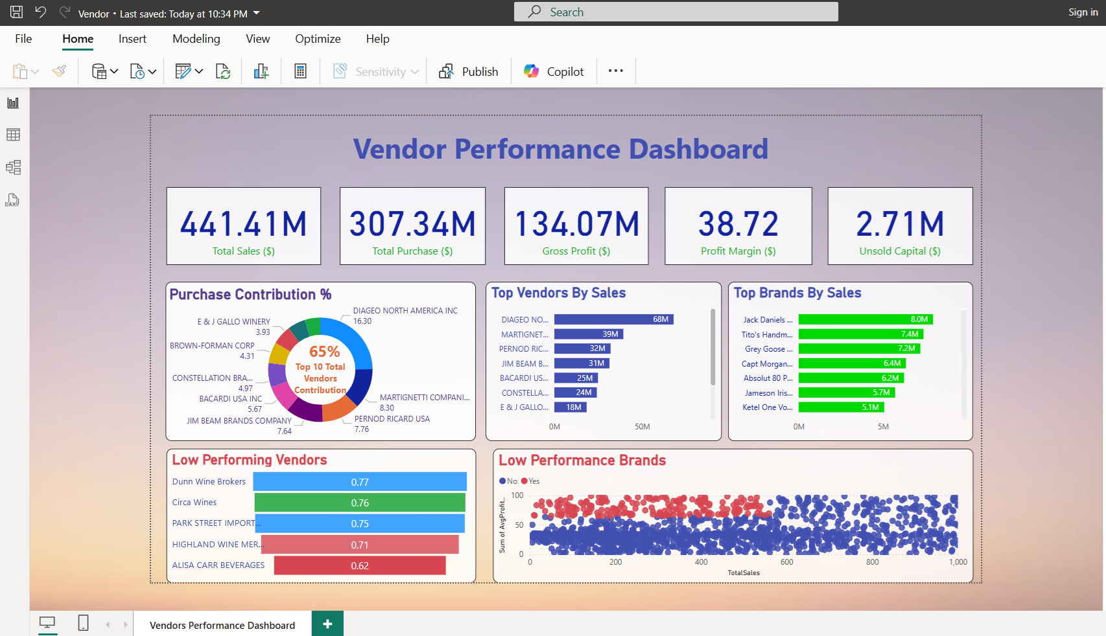

Slide 3
Exploratory Data Analysis Insights
Summary Statistics

Slide 4
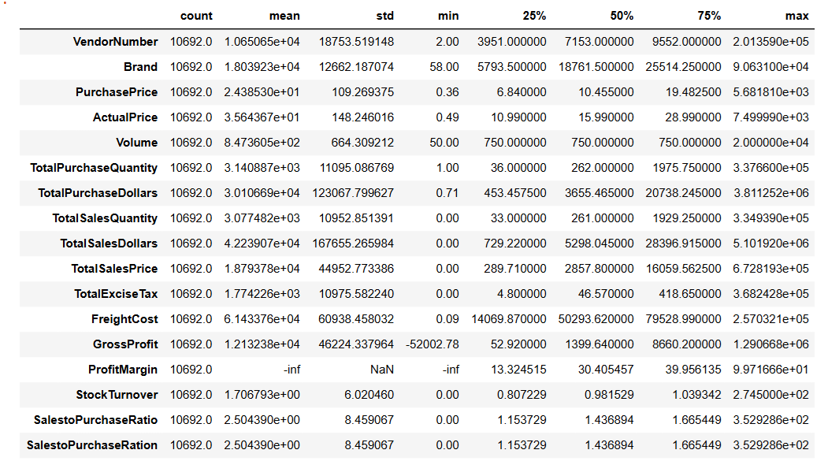

Slide 5
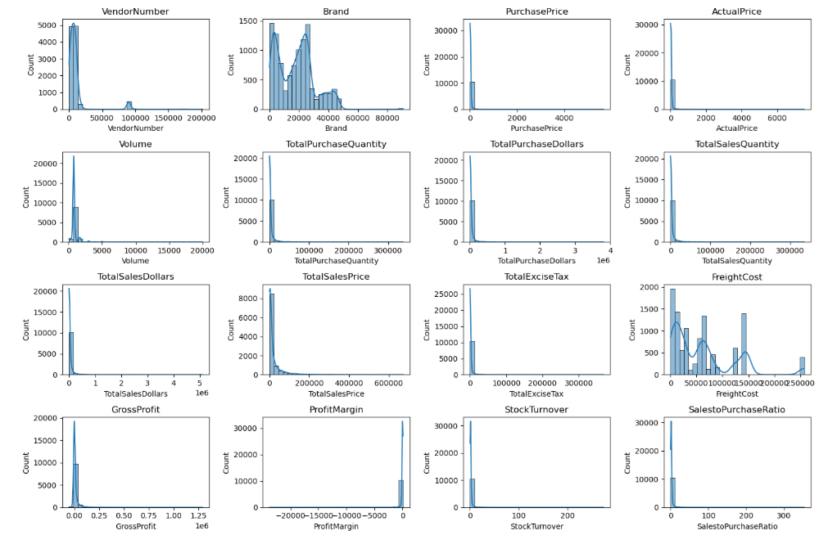

Slide 6
Negative & Zero Values:
Gross Profit: Minimum value is -52,002.78, indicating losses. Some products or transactions may be selling at a loss due to high costs or selling at discounts lower than the purchase price…
Profit Margin: Has a minimum of -∞, which suggests cases where revenue is zero or even lower than costs.
Total Sales Quantity & Sales Dollars: Minimum values are 0, meaning some products were purchased but never sold. These could be slow-moving or obsolete stock.
Outliers indicated by High Standard Deviations:
Purchase & Actual Prices: The max values (5,681.81 & 7,499.99) are significantly higher than the mean (24.39 & 35.64), indicating potential premium.
Freight Cost: Huge variation, from 0.09 to 257,032.07, suggest logistics inefficiencies or bulk shipments.
Stock Turnover: Ranges from 0 to 274.5, implying some products sell extremely fast while others remain in stock indefinitely. Value more than 1 indicates that Sold quantity for that product is higher than purchase quantity due to the sales are being fulfilled from older stock.

Slide 7
Data Filtering
To enhance the reliability of the insights, we removed inconsistent data points where:
Gross Profit ≤ 0 (to exclude transactions leading to losses)
Profit Margins ≤ 0 (to ensure analysis focuses on profitable transaction)
Total Sales Quantity = 0 (to eliminate inventory that was never sold).
Correlation Insights
PurchasePrice has weak correlation with TotalSalesDollars (-0.012) and GrossProfit (-0.016). suggesting that price variations do not significantly impact sales revenue or profit.
Strong correlation between total purchase quantity and total sales quantity (0.999), confirming efficient inventory turnover.
Negative correlation between profit margin & total sales price (-0.179) suggests that as sales price increases, margins decrease, possibly due to competitive pricing pressures.
Stock Turnover has weak negative correlations with both GrossProfit (-0.038) and ProfitMargin (-0.055), indicating that faster turnover does not necessarily result in higher profitability.

Slide 8
Data Analysis
Identify Brands that needs Promotional or Pricing Adjustments which exhibit lower sales performance but higher profit margins.
Vendors buying in bulk (Large Order Size) get the lowest unit price ($10.78 per unit), meaning higher margins if they can manage inventory efficiently.
The price difference between Small and Large orders is substantial (-72% reduction in unit cost)
The suggests that bulk pricing strategies successfully encourage vendors to purchase in larger volumes, leading to higher overall sales despite lower per-unit revenue.
The confidence interval for low-performing vendors (40.48% to 42.62%) is significantly higher than that of top-performing vendors (30.74% to 31.61%).
This suggests that vendors with lower sales tend to maintain higher profit margins, potentially due to premium pricing or lower operational costs.
For High-Performing Vendors: If they aim to improve profitability, they could explore selective price adjustments, cost optimization, or building strategies.
For Low-Performing Vendors: Despite higher margins, their low sales volume might indicate a need for better marketing, competitive pricing, or improved distribution strategies.

Slide 9
Is there a significant difference in profit margins between top-performing and low-performing vendors?
Hypothesis:
H˳(Null Hypotheses): There is no significant difference in the mean profit margins of top-performing and low-performing vendors.
H1(Alternative Hypothesis): The mean profit margins of top-performing and low-performing vendors are significantly different.

